Slide 1
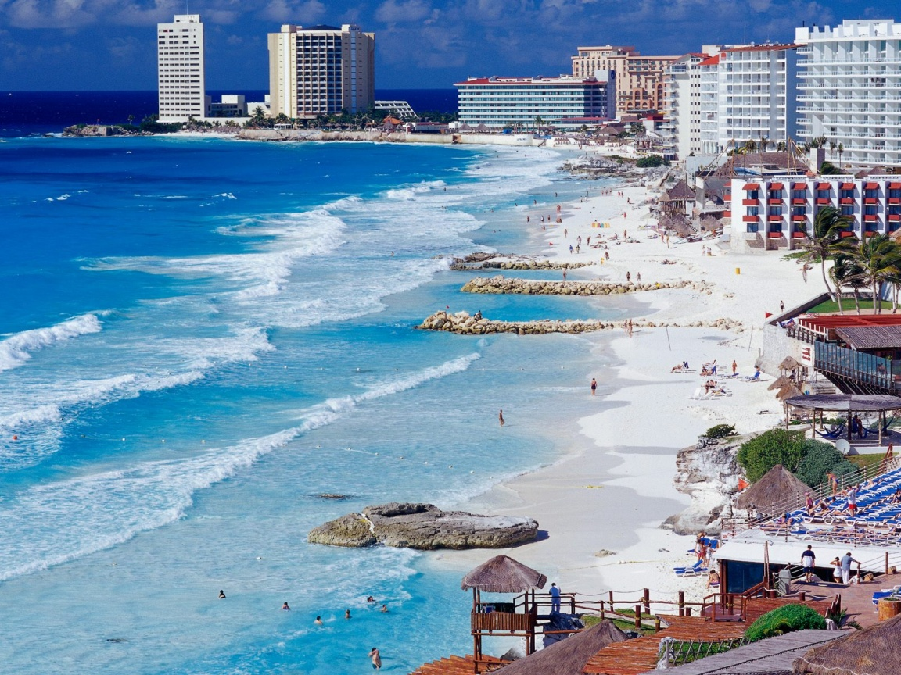
Spring Break 2010
Cancun, Mexico
Notes:
Why I decided to help organize. Negril = Best time of my life.

Slide 2
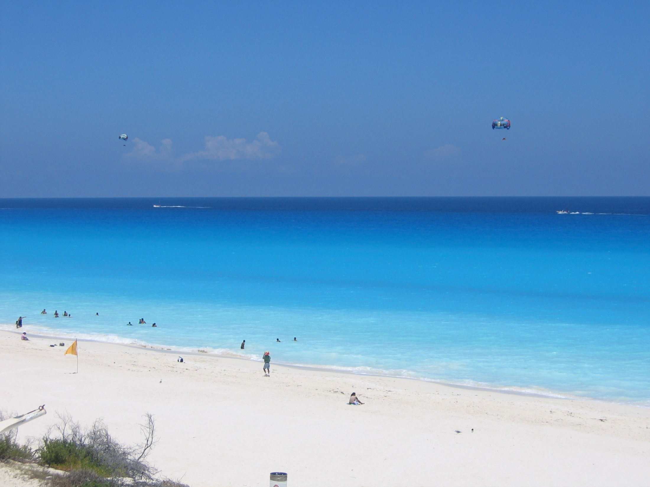
Why Cancun?
Rated #1 Spring Break Destination
White sand, turquoise water, warm sunny skies
Great value!
ONCE IN A LIFE TIME EXPERIENCE

Slide 3
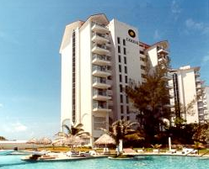
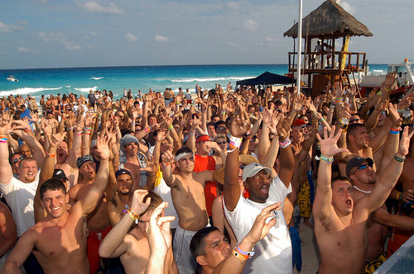
What happens in Cancun…
Carisa y Palma Condos
Right on the beach with a pool
Popular SB hotel with “kitchen” in room
Centrally located; just about everything we need is walking distance
3/5 star rating from TripAdvisor
4 people per room (can upgrade)
VIP Party Pass
Major party each night
Basically all we can drink
VIP access – no lines or cover
Happy hours, day events
Best of all…
Hang out with friends, meet new people, and just relax!
Notes:
Extra $20 off if group of 17

Slide 4
Logistics
DATES: Sunday, March 7 to Friday, March 12 (5 nights)
Departure:
Flight departs BWI at 6 AM
Mini Limo Bus Carpool included in price
Van transfer in Cancun to Hotel
Hotel
First choice: Carisa Y Palma
Second Choice:
Return:
Flight departs Cancun at 7 AM
Same arrangement as going, but reverse
Flights subject to change based on pricing and availability!!!

Slide 5
Safety
“Cancun is amongst the safest places to travel in Mexico and is known throughout Mexico for its low crime rate” – Trip Advisor
Booking through a reputable operator
A+ Rating through BBB, licensed, founded in 2003
Welcome/safety orientation
Operation staff available 24/7
Department of State highlights preventative measures to avoid problems
Will be traveling in groups
Supplemental insurance available
Student Travel Services

Slide 6
Money
What’s included:
Just about everything you need except food & shopping
Lots and lots of drinks
VIP Party Pass
All cover charges and club/bar admissions at the major party each night
Twin hotel room (4 people per room)
Air fare to/from Cancun
Transfers: transport to/from BWI, transport from/to CUN
Taxes and fees assessed by airline, travel agent, and hotel
A VERY nice group discount!!!
All of this for only…
$825.00

Slide 7
Money
What’s not included:
Food
T-shirts
Travel Insurance
Some optional happy hours
Other activities like wave runners, parasailing, etc.

Slide 8
You want in?
DEADLINE TO SIGN UP
Tuesday, January 19 at 2 PM
Important things to note:
$825.00 was most recent price quoted Friday, Jan. 15
May go up or down due to airfare
If you sign up, I will not reconfirm price unless exceeds $50 more than this price
Hotel/flights may change due to availability based on my sole judgment. I will communicate these changes immediately if they are made.
One you sign up, you are financially responsible for any expenses incurred on your behalf up to what is stipulated above
Notes:
SIGN UP EARLY – tickets at certain rates may get sold out and the fare may increase. The travel agent will book tickets in the order of signups
ROOMS – will work out later, but if you want to try to get a double occupancy or tripple occupany room, let me know

Slide 9
Signing Up
http://sb2010.joelcroft.com
Have your passport with you!
Sign up by: Tuesday, January 19 at 2 PM
Credit Card or Check
Sign up early!!
Air rates will be given in the order you sign up!!
Notes:
SIGN UP EARLY – tickets at certain rates may get sold out and the fare may increase. The travel agent will book tickets in the order of signups
ROOMS – will work out later, but if you want to try to get a double occupancy or tripple occupany room, let me know

Slide 10
Questions?

